Slide 1
Embedding/De-Emdedding RF Measurements and In-Fixture Calibration
Advanced R&D
2020.08
Felipe Kalinski

Slide 2
Objectives
Generate de-embedded s-parameters for the SKY66420 FEM operation modes:
Bypass mode
TX Mode TX_ALT and PA_OUT pins
TX Mode TX_IN and ANT pins
Find the optimum load impedance:
S2-LP
SX1262
BlueNRG LP
Design Validation Measurements
SKY66420
S2-LP
SX1262
BlueNRG LP

Slide 3
Equipments
Sigfox SDR Dongle;
Sigfox RSA V2.0.0;
40dB Attenuator;
HTSX32MO32L Socket (AndkSocket);
Temperature Test Chamber (ITT Fuse);
Spectrum Analyzer (Tektronix RSA 306);
ST-Link (Evaluation Board SiP V2.1);
V2.2 open SiP HTSXMO32L;
Green Test Board (V2.1 – manually modified).

Slide 4
Materials
Sigfox SDR Dongle;
Sigfox RSA V2.0.0;
40dB Attenuator;
HTSX32MO32L Socket (AndkSocket);
Temperature Test Chamber (ITT Fuse);
Spectrum Analyzer (Tektronix RSA 306);
ST-Link (Evaluation Board SiP V2.1);
V2.2 open SiP HTSXMO32L;
Green Test Board (V2.1 – manually modified).

Slide 5
Outline
Methods
Optimum Impedance Table
Definitions
Measurement Setup

Slide 6
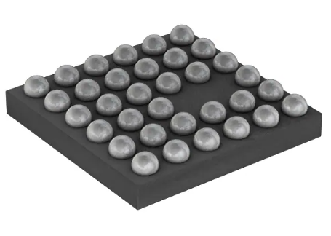
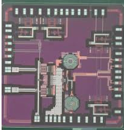
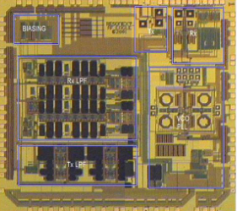
Methods
Optimum Impedance Table: Based in LoadPull measurements determines the optimum impedance for transmitter circuits. We’ll compare two approaches:
Direct measurements, one port calibration (Semtech)
Place a SMA SMD connector footprint behind the TX output pad
Emdedding the test fixture effects – Post Processing
Measure and generate the test-fixture model
Read the Impedance Tuner value
Post-Process: Embedd the test-fixture model into the impedance tuner measurement
BlueNRG
SX1262
S2-LP

Slide 7
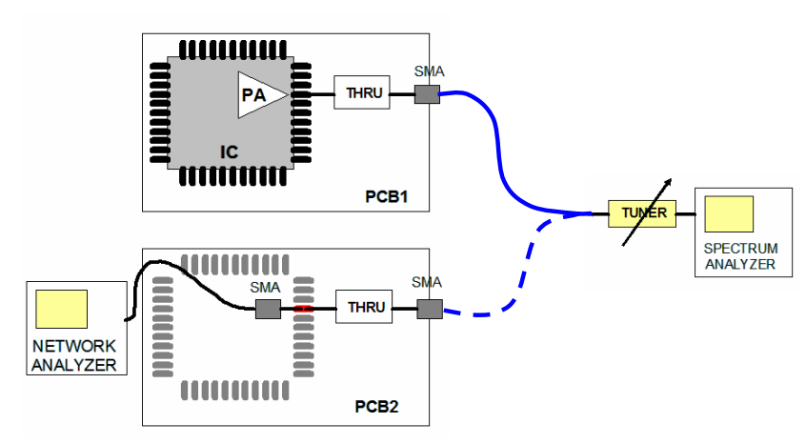
MEASUREMENT SETUP 1 – One Port LoadPull Based
Used for Direct Measurements
#1 Find the Optimum Load Impedance
#2 Impedance Direct Measurement
SEMTECH - AN 1200.04: RF Design Guidelines: PCB Layout and Circuit Optimization

Slide 8
MEASUREMENT SETUP 2 – One Port LoadPull Based
Used for:
S2-LP
SX1262
BlueNRG
VOLTAGE SOURCE
PCB – TEST FIXTURE
BIAS CIRCUITRY
SPECTRUM ANALYSER
CHIP
TRANSMISSION LINE
RF CONNECTOR
IMPEDANCE TUNER

Slide 9
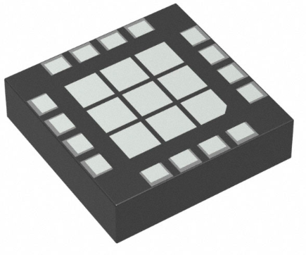
Methods
De-Embedded Device S-Parameters: based in test fixture VNA measurements embed or de-embed the S-Parameters
De-embed - TRL in-fixture calibration
De-embed - SOLT in-fixture calibration
Embed - Fixture model generation – TRL
Embed - Fixture model generation – Direct measurement
SKY66420

Slide 10
Methods
De-Embedded Device S-Parameters for SKY66420 will need the following boards:
Test Fixture
SCHSKM001
In-Fixture Calibration
SCHCTL001 - In-Fixture TRL
SCHCOL001 - In-Fixture SOLT
De-Embed
SCHFXM001 – Fixture modeling

Slide 11
MEASUREMENT SETUP 1 – 2 Ports VNA Based
Used for SKY66420
VOLTAGE SOURCE
PCB – TEST FIXTURE
BIAS CIRCUITRY
RF CONNECTOR
TRANSMISSION LINE
CHIP
TRANSMISSION LINE
RF CONNECTOR
VNA

Slide 12
Required Designs
This project will need this PCB: 140x140
2 - ½ THRU: (45x25) Test Fixture Modeling
1 - TRL/SOLT OPEN (72x25)
1 - TRL/SOLT REFLECT (72x25)
3 - TRL/SOLT TRHU (60x25)
1 - TRL LINE 0.375-3GHz (72x25)
6 - TRL LINE 1-8GHz (60x25)
4 - SOLT LOAD (45x25)
5 - Bias Tee (45x25)
Model gen: 100x140
WB Model (short+ long length) (60x25)
SKY66420 model – w/o bias (60x30)
BlueNRG Model - w/o bias (60x30)
S2-LP Model - w/o bias (60x30)
SX1262 Model - w/o bias (60x30)

